Slide 1
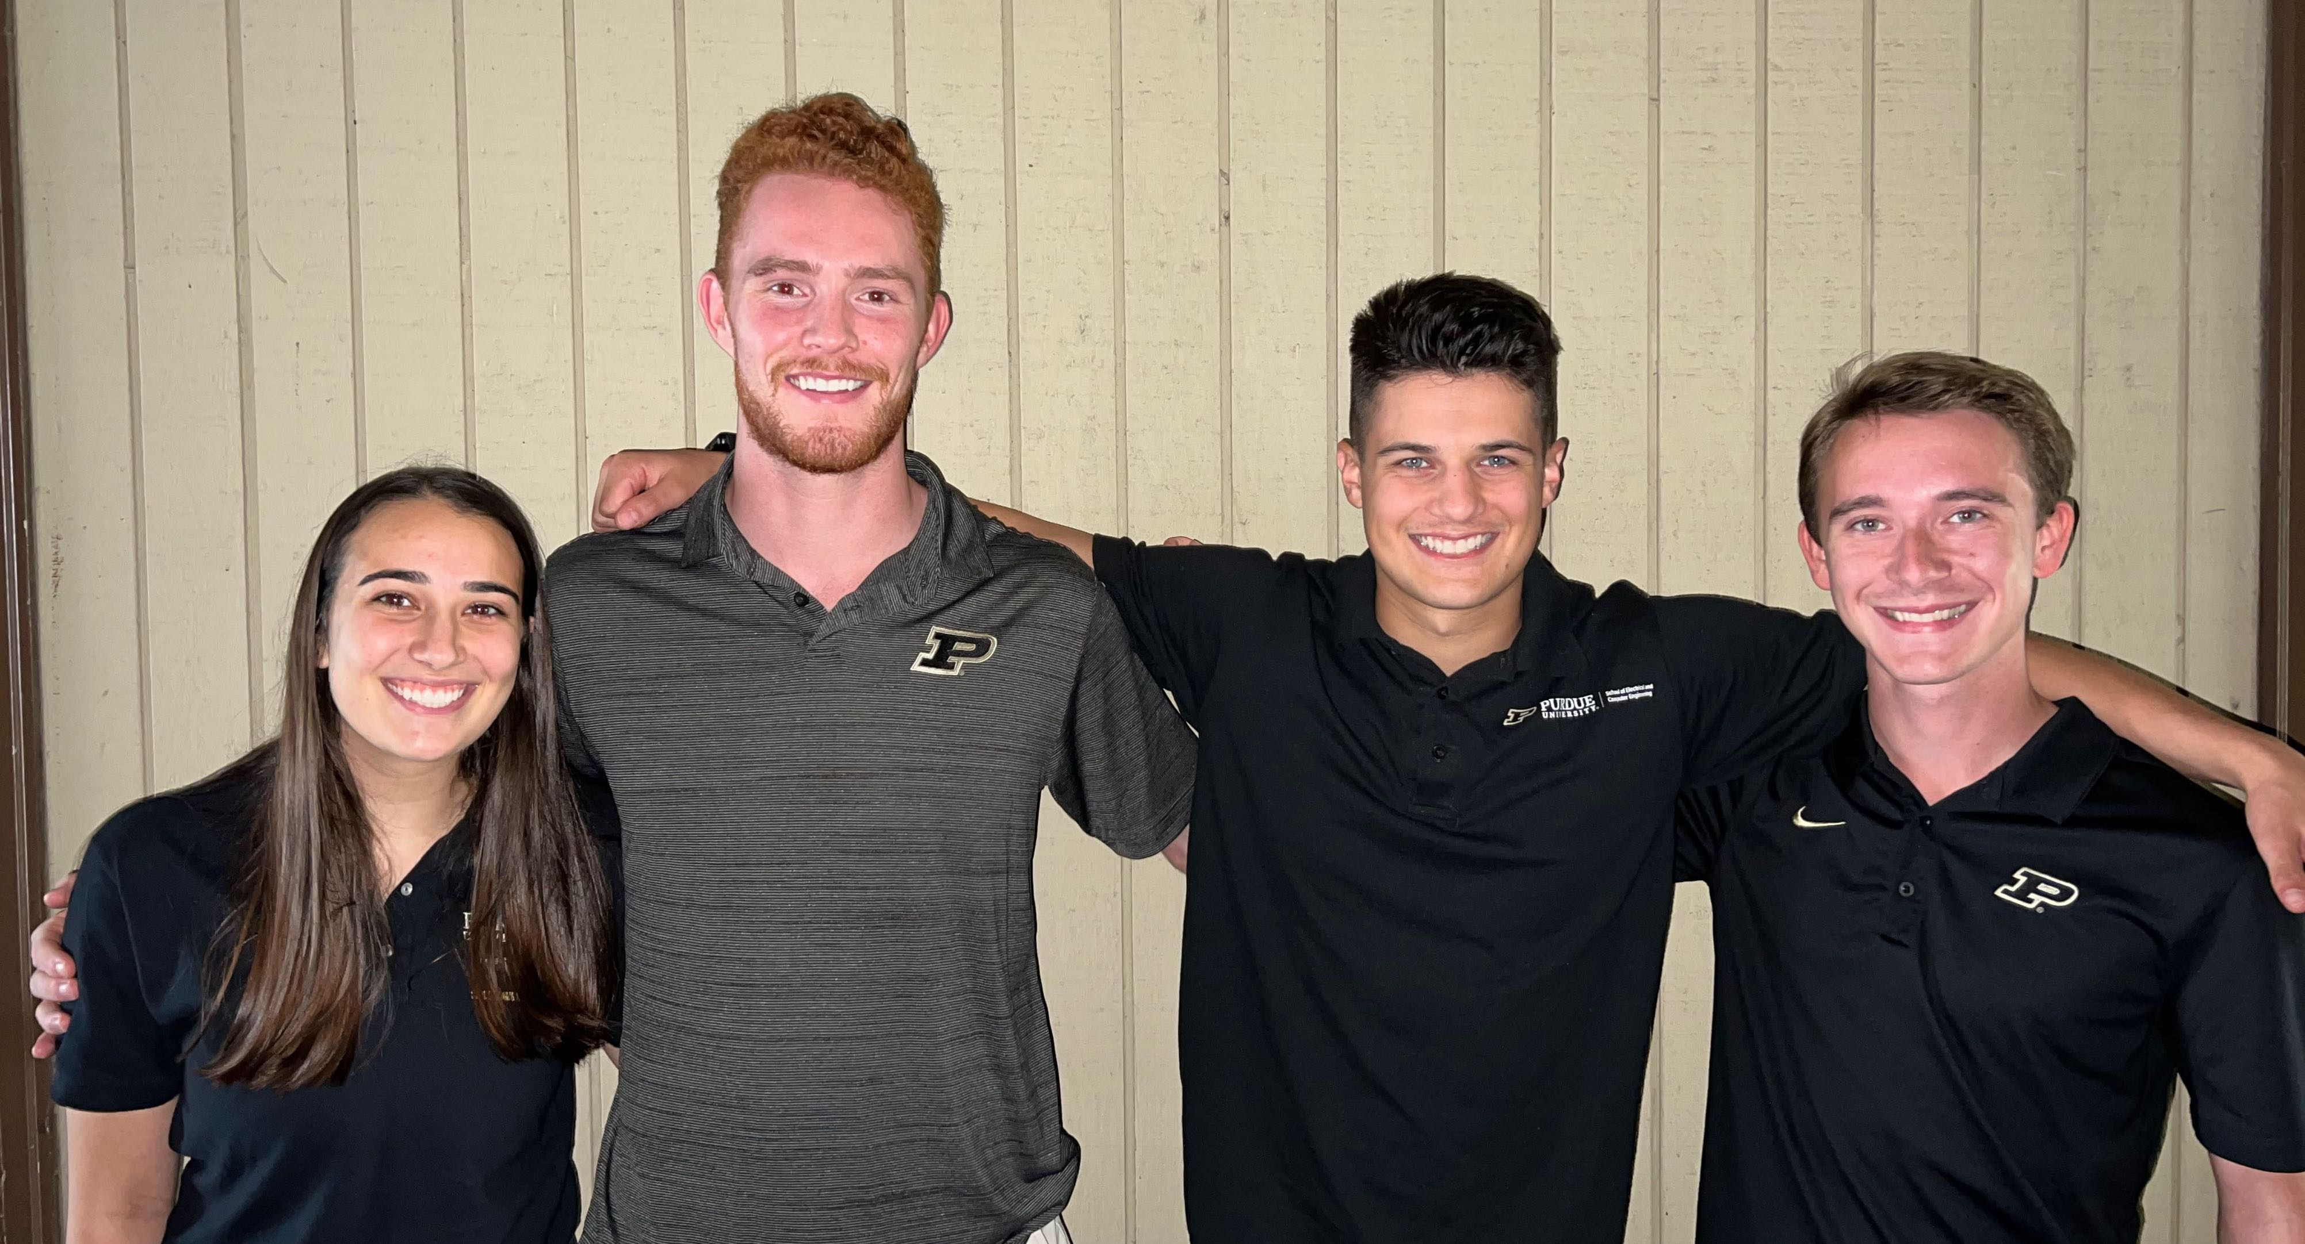
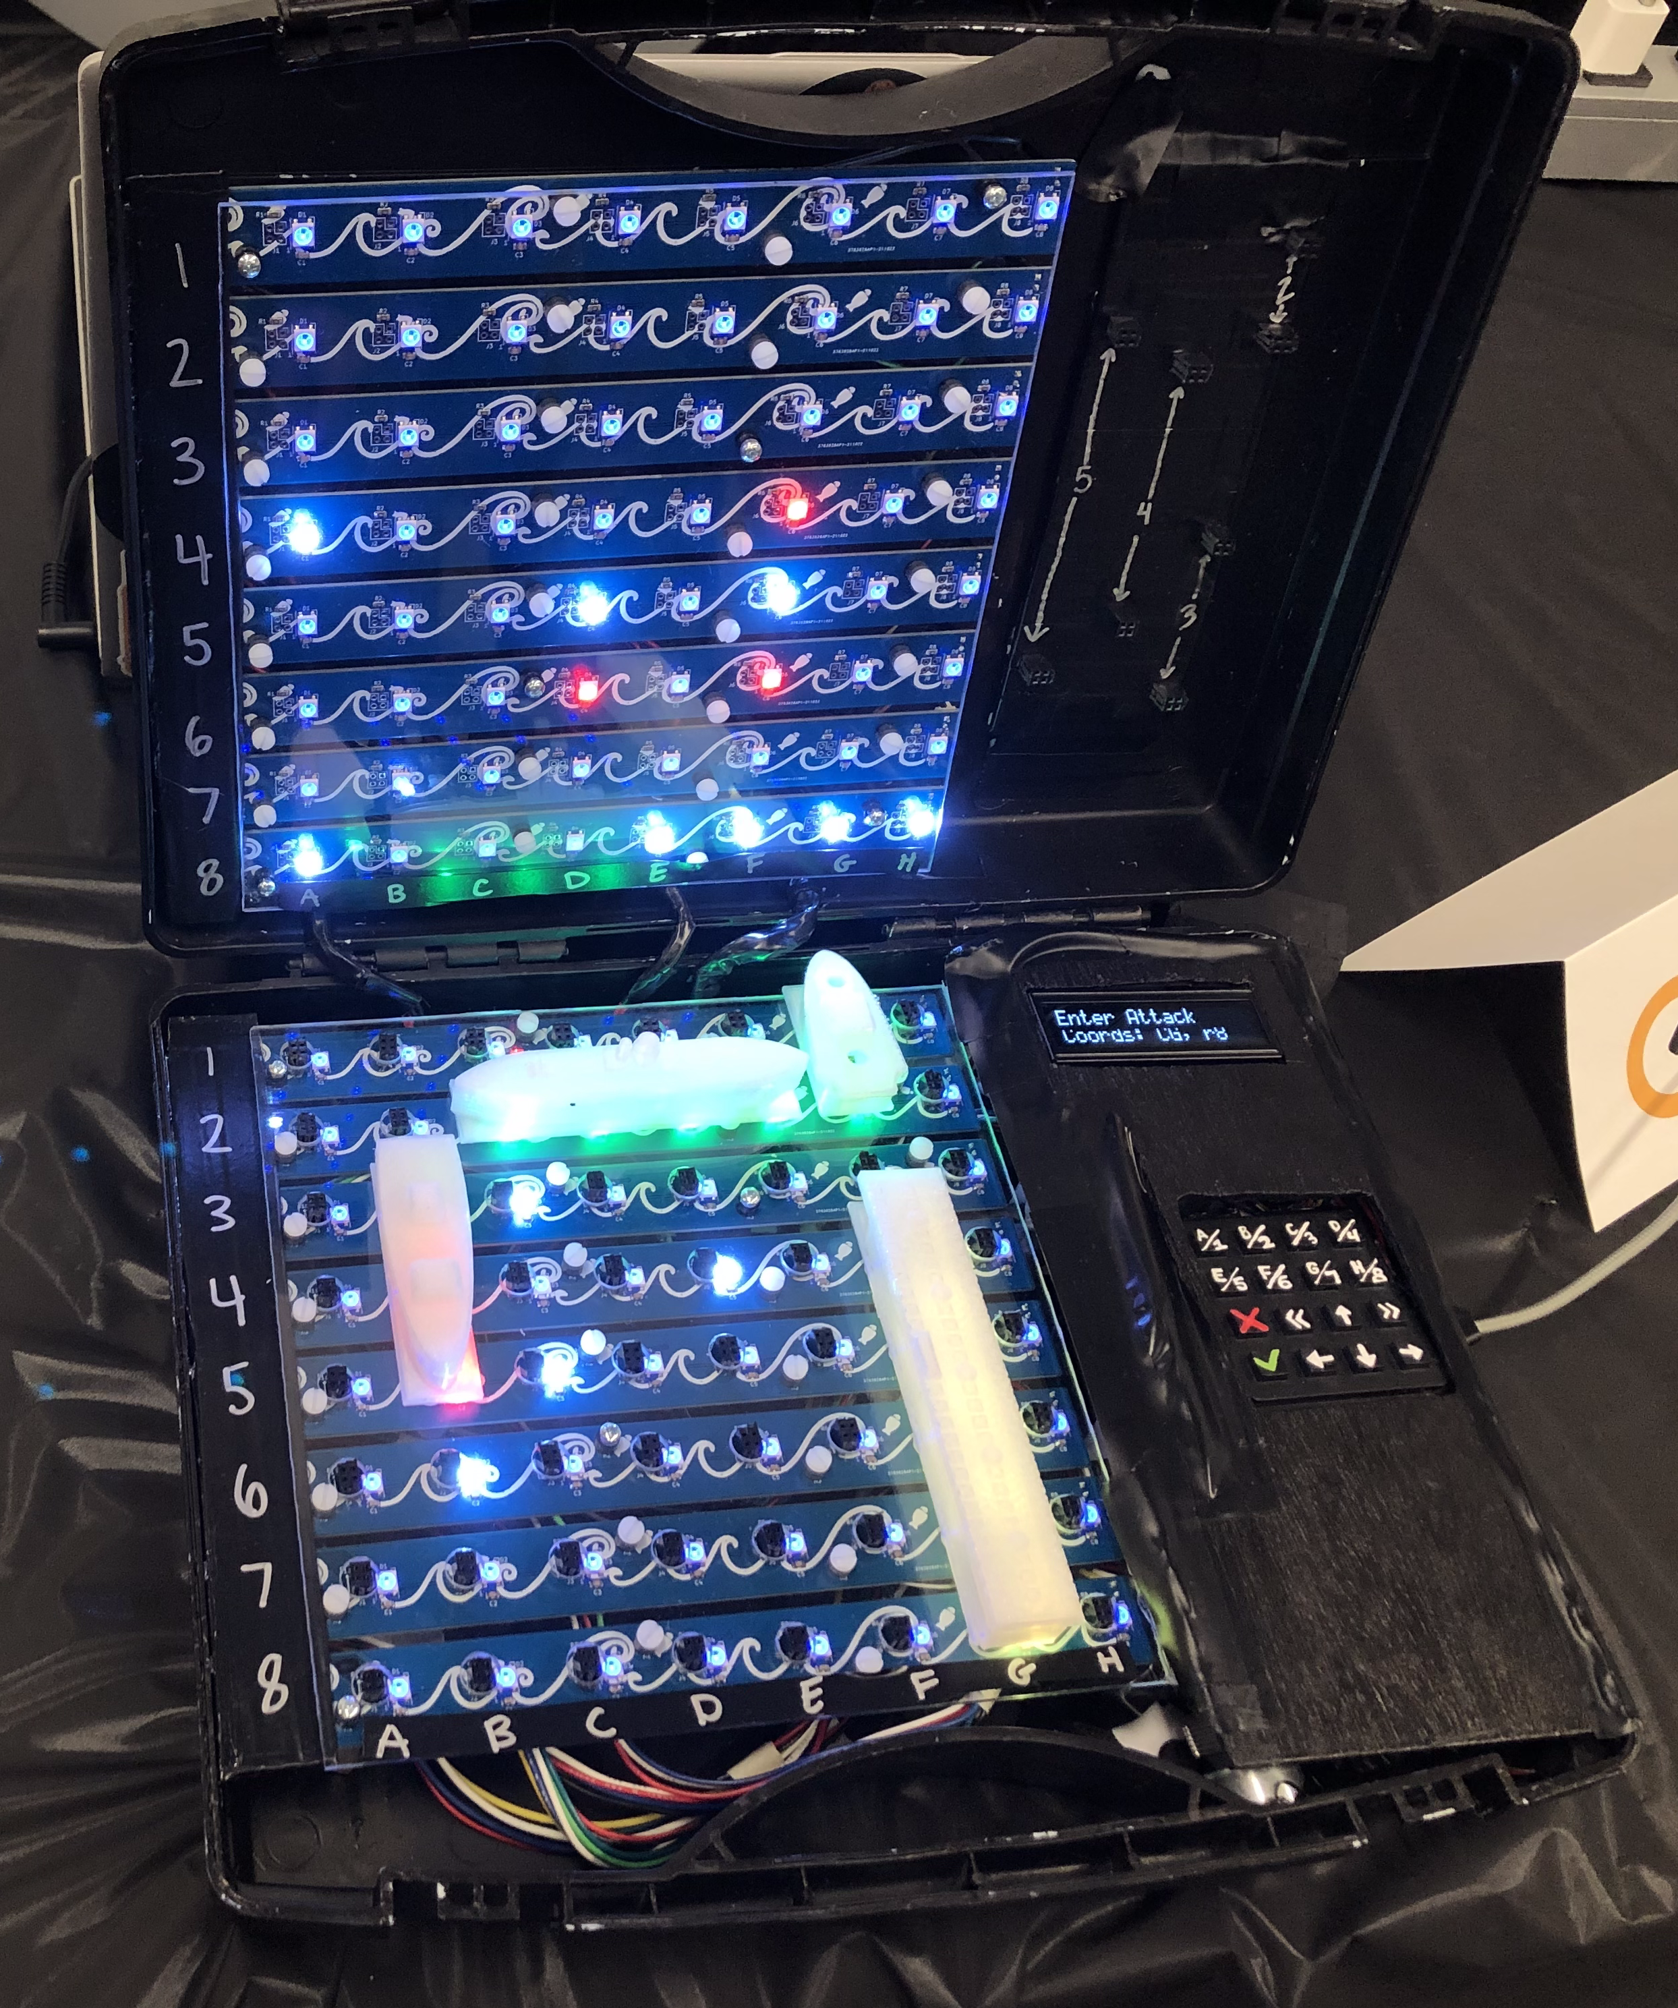

ECE 477 Final Review: Team 8

Slide 2
Outline
Project Overview
Block Diagram
Design Challenges
Individual Contributions
Project Demonstration
Questions

Slide 3
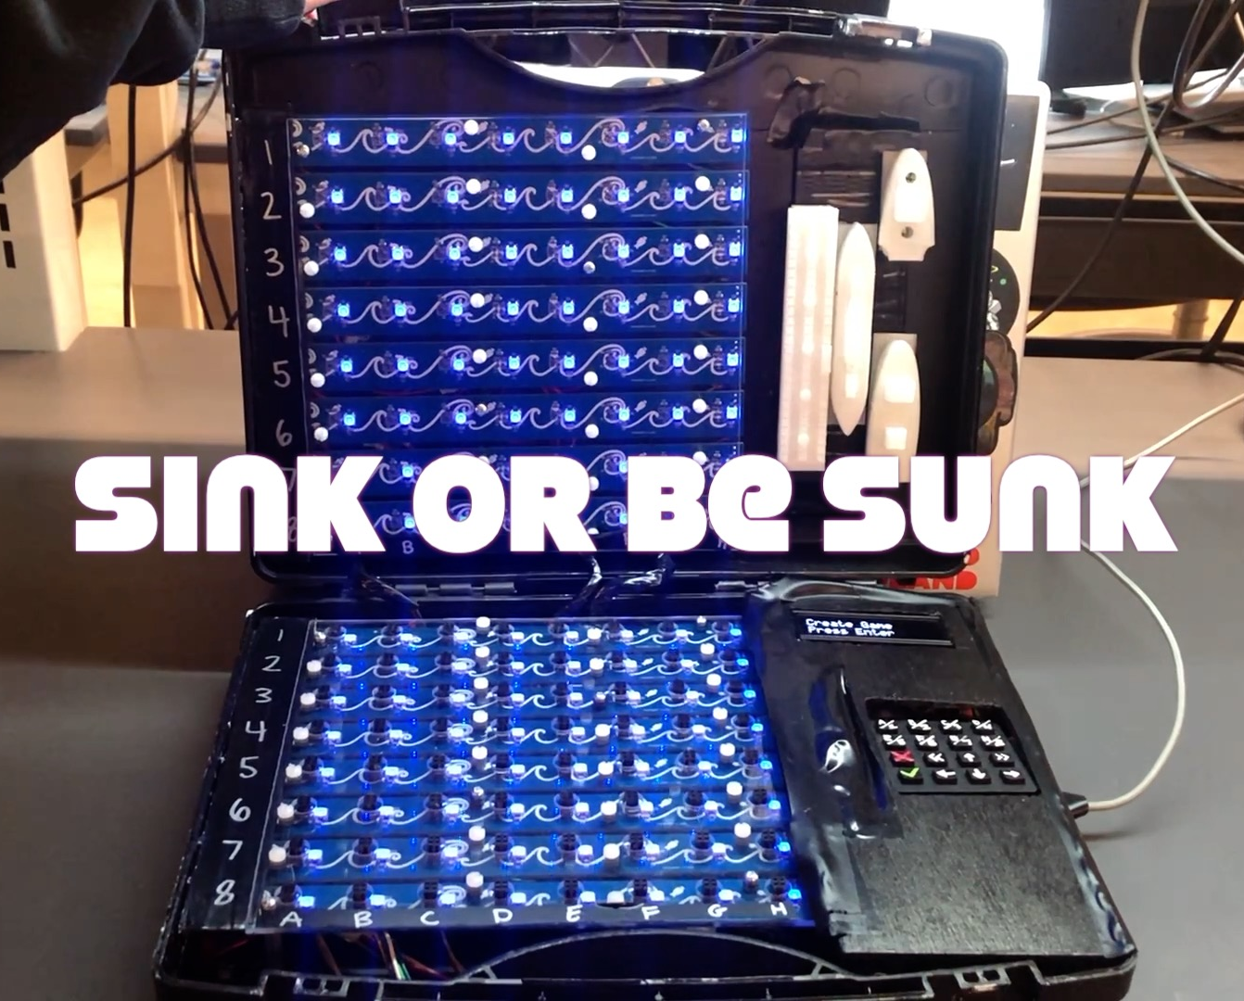
Project Overview
Sink or be Sunk is a 21st century take on Hasbro’s classic Battleship
Allows users to play at a distance through Wi-Fi enabled boards that communicate with an online server
Incorporates tactile user input like the original game.
Includes visual and haptic feedback.

Slide 4


Block Diagram
Game Server
Legend
USB
Power
5V
DCDC Converter
Display
3.3 Volts
5 Volts
User
Device
3v3
Wi-Fi
Button Matrix
4x4
4 (SPI)
4 (rows)
BLE
4 (cols)
Microcontroller
ESP32
1(enable)
3 (column select)
Motor
Driver
5V
Rumble Motor
3(row select)
1 (led ctrl)
8 (column
positions)
Ship Slot 0
8x1
Mux0
LED Daisy Chain 1
1 (selected
ship position)
…
…
8 (row positions)
8x1
Mux
8 (column
positions)
…
Ship Slot 63
8x1
Mux7
LED Daisy Chain 128

Slide 5
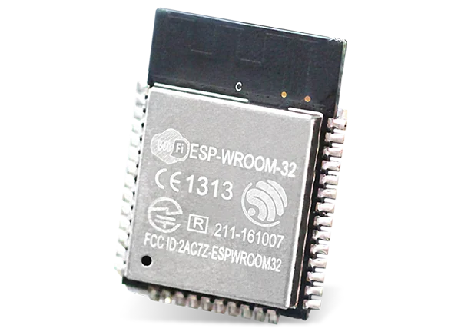
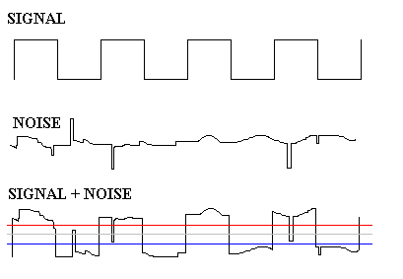
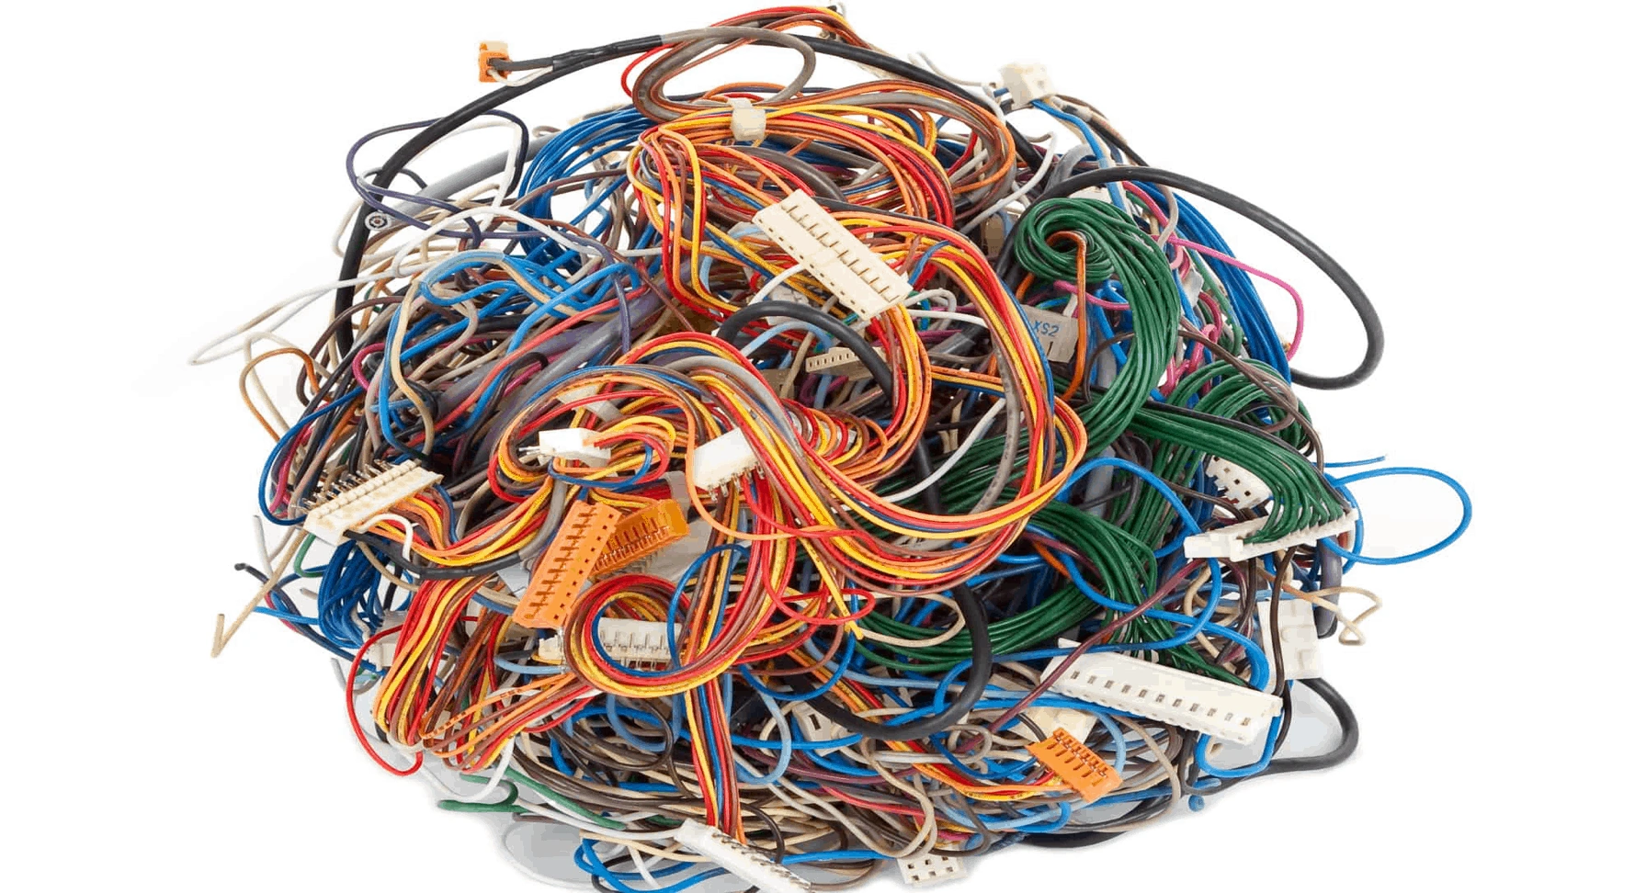
Design Challenges
Design
Improper definition of ESP32 Pins
Serial Programmer
Speaker – Power/Volume, Software Constraints
Debugging
Noise in Daisy-Chained LEDs
Boat Detection Floating Connections
Implementation
Cabling
Soldering

Slide 6
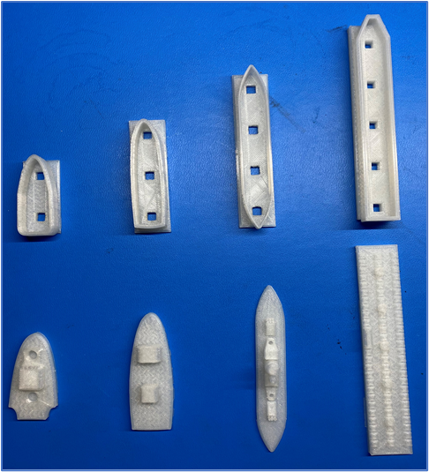
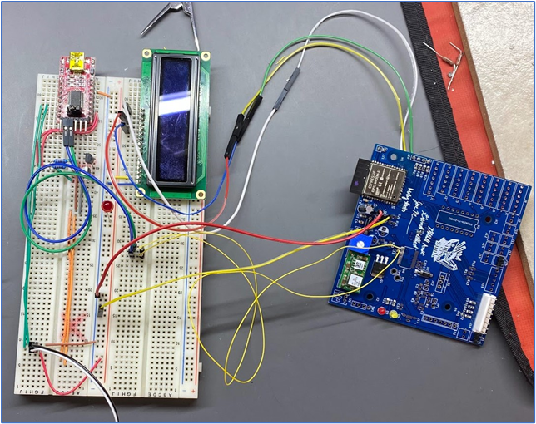
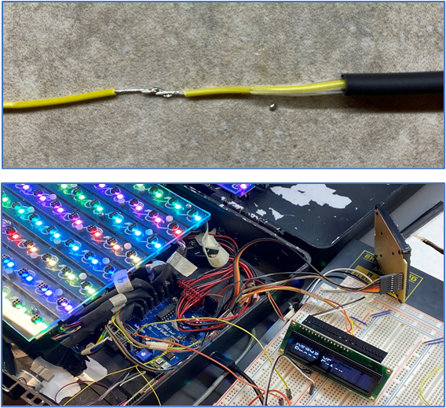
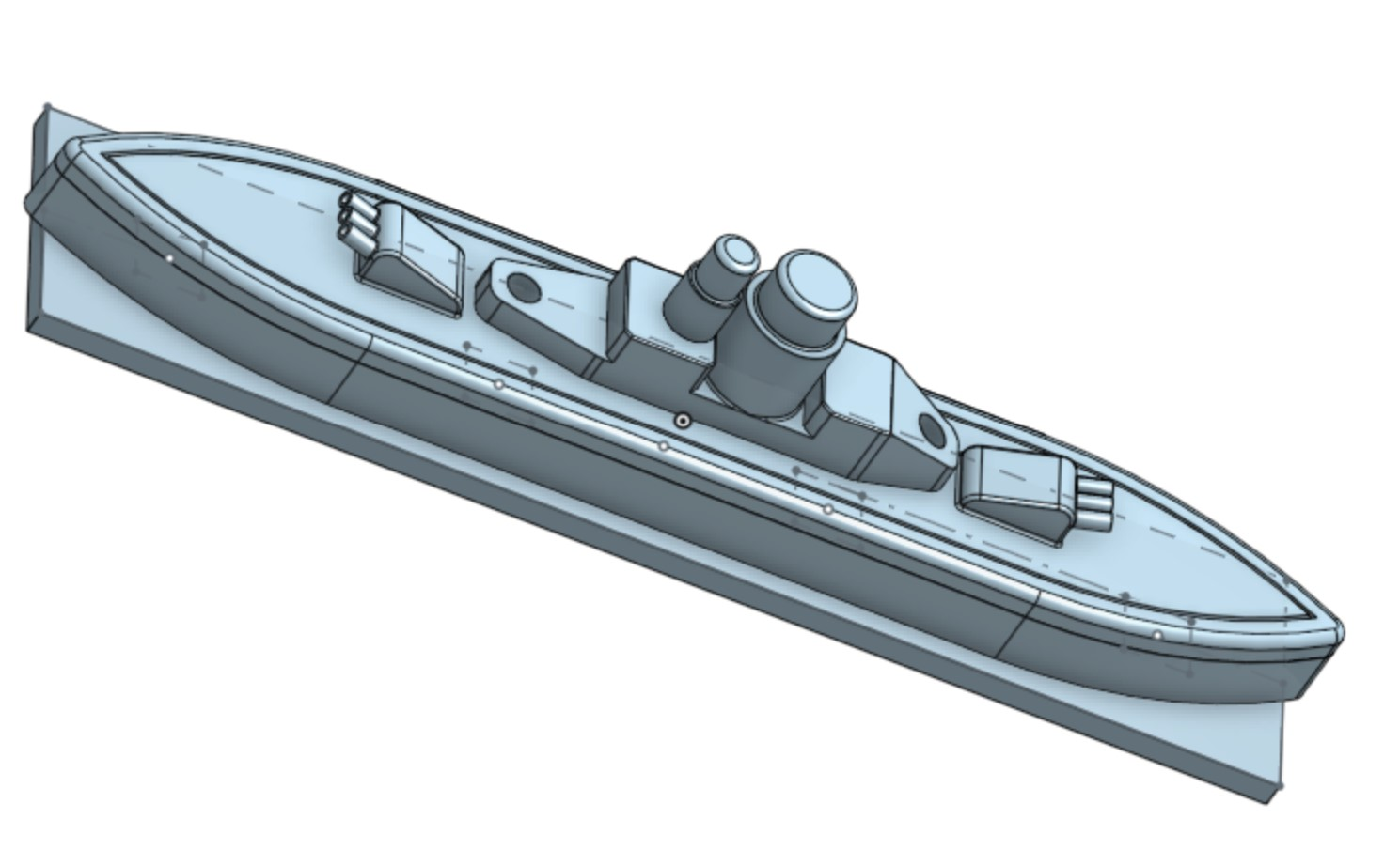
Individual contributions
Molly Arito
Design
3D Printing boats
Implementation
Soldering Main and Grid PCBs
Integration
Cabling – splicing wires, soldering together, heat shrinking
Reviewing initial schematics and PCB layout
Component ordering and budgeting
Reflowing weak solder joints after stenciling
Basic testing to ensure hardware functionality
Wooden panel for LCD, Keypad, and coverage

Slide 7
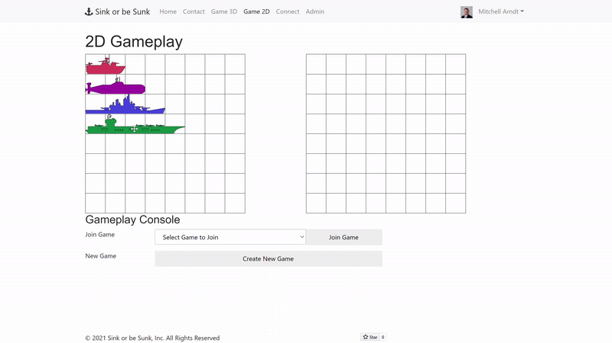
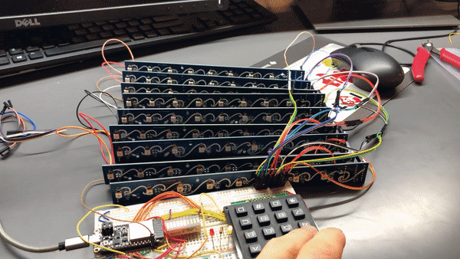
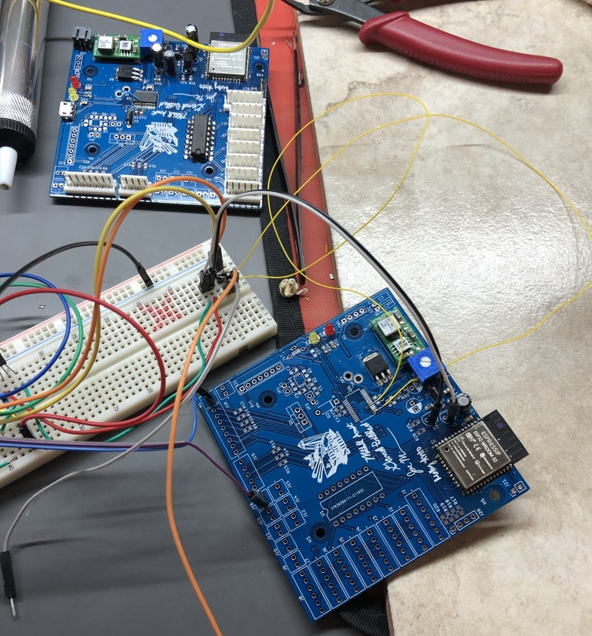
Individual contributions
Mitch Arndt
Server
Game Logic
User Account Database
Auto Deployment
PCB
Circuit Design and Prototyping
Layout place and routing
Fly-wiring/Debugging
Embedded
LED Grid and Rumble Motor Control
Integration (C++ classes)
RTOS configuration

Slide 8
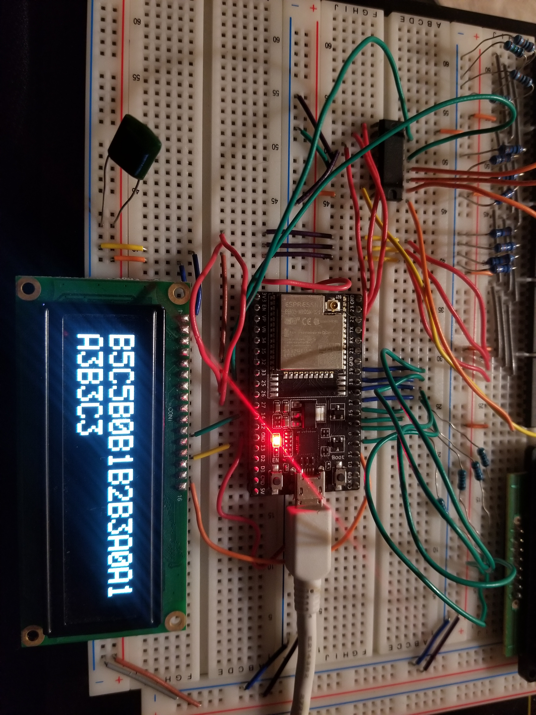
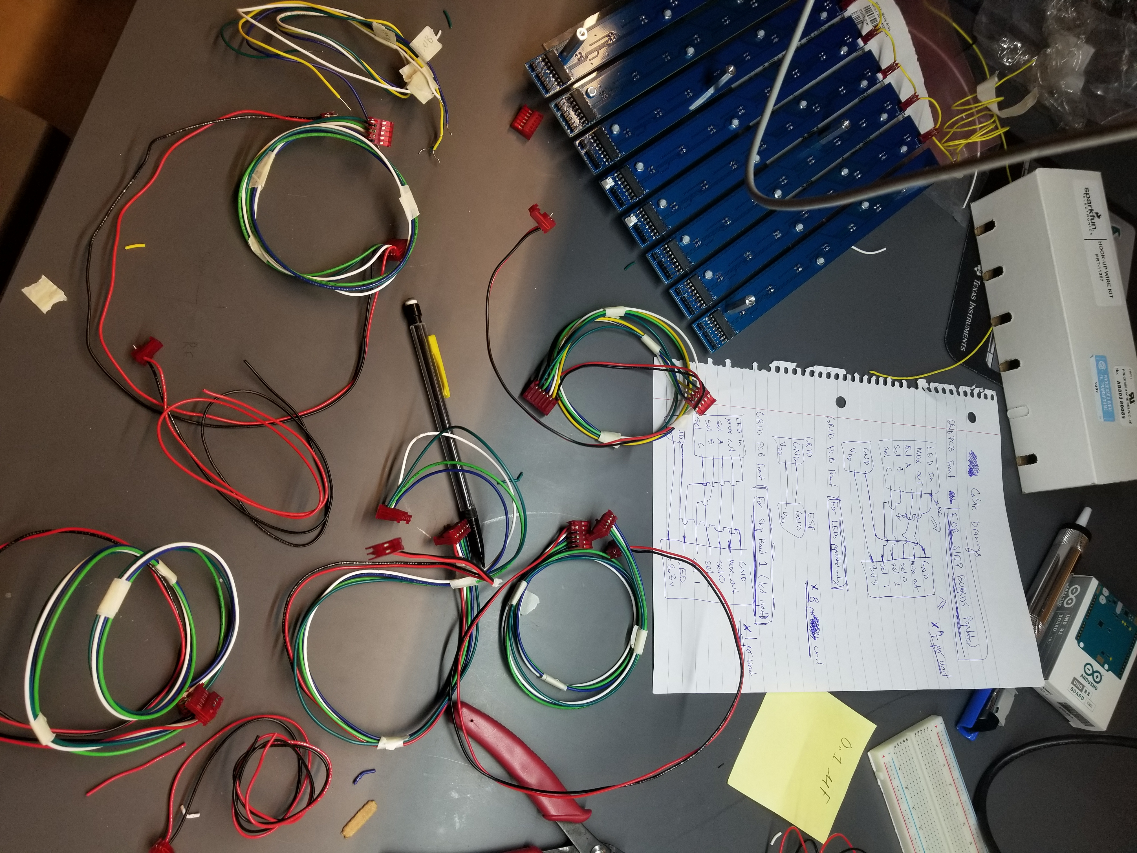
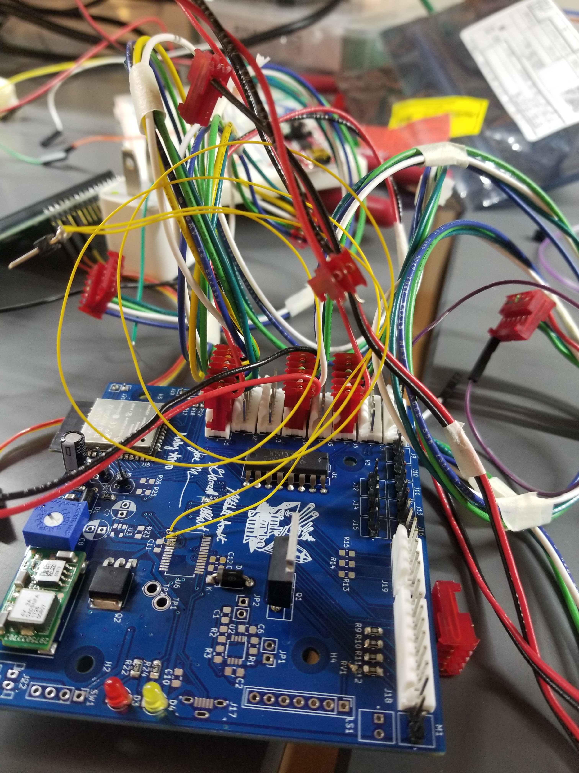
Individual contributions
Garrett Brillhart
Prototyping keypad, boat detection, OLED/SPI
Embedded Design
OLED/SPI communication
Boat Detection
Packaging/Assembly
Header pins
Grid PCB Assembly with Acrylic
Cabling/Assembly
Box Implementation

Slide 9
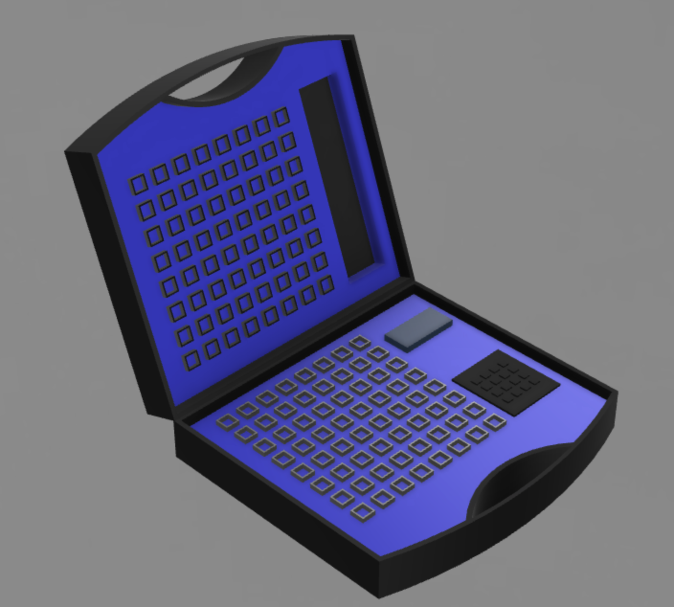
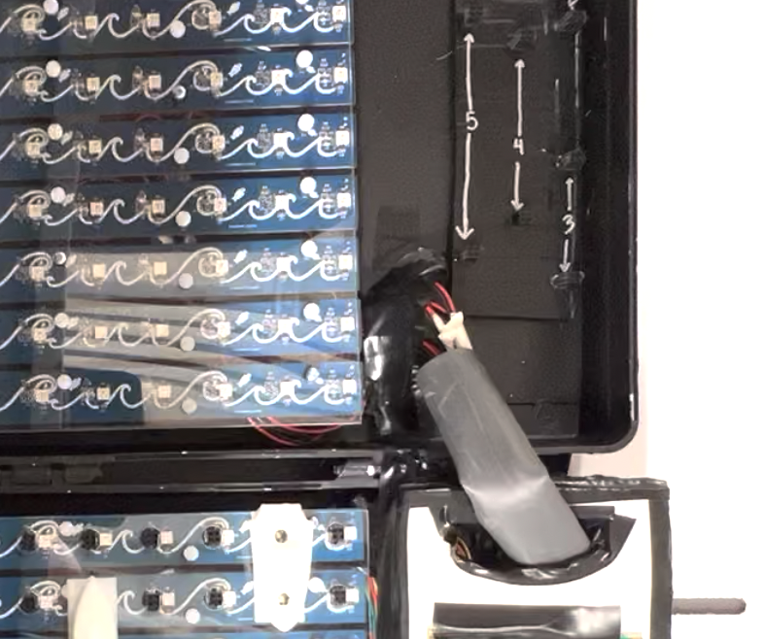
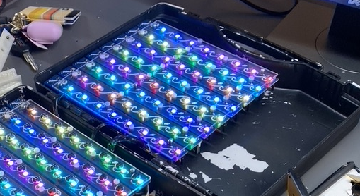
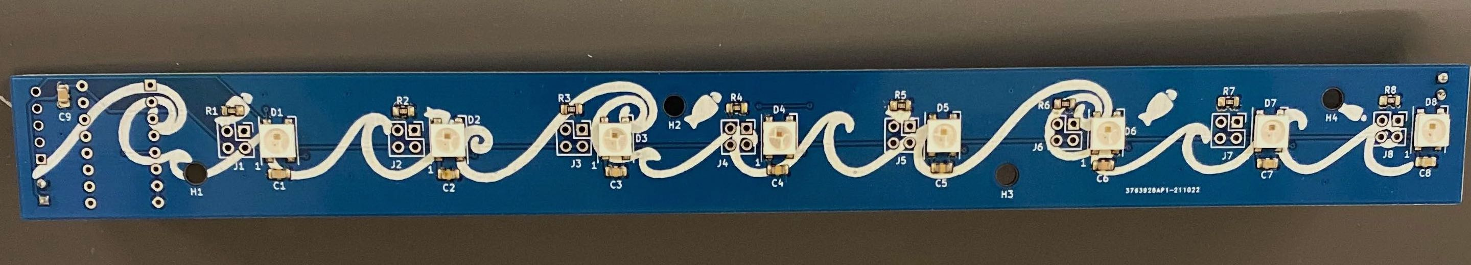
Individual contributions
Joe Mislansky
CAD realization of physical product
Virtual version Sink or be Sunk
Stencil soldering
Testing grid PCBs for LEDs and boat detection
Cable organization/installation of final pieces

Slide 10
Project Demonstration
PSSC #1: An ability to provision a Wi-Fi connection through a Bluetooth BLE connection to a user's smartphone.
PSSC #2: An ability to detect when a user positions their ship pieces on the game board.
PSSC #3: An ability to relay game move information between players over an internet connection.
PSSC #4: An ability to light individual LEDs in a matrix in response to game events.
PSSC #5: An ability to provide physical feedback to a user with a rumble motor when a ship is sunk.
Sink or be Sunk Demonstration - YouTube

Slide 11

Questions?

